Slide 1

Hostel Attendance System Based on
Finger Print Authentication
SMDR Government Polytechnic, Dhule
Guided by- Prof. Nayana Borase Mam

Slide 2
Submitted By -
Renuka Satish Bhavsar - 317
Unnati Dhanraj Kulkarni -338
Bhavana Lotan Patil - 339
Harshada Rajendra Koli -342
Branch – Computer (6th sem)

Slide 3

1. Problem Statement
2. Abstract
3. Introduction
4. Literature review
5. Methodology
6. Diagrams
7. Output
8. Resource Required
9. Conclusion
10.Reference

Slide 4
Problem Statement
Following some problem which solve by this software:
Safety and Security: Ensuring the safety of the hostel residents is paramount. By promptly notifying hostel authorities when a girl is missing, the system enhances security measures and enables quick response in case of emergencies or potential threats.
Efficient Management: Manual attendance tracking processes are time-consuming and prone to errors. By automating attendance monitoring and alerting, the system streamlines management tasks, allowing hostel staff to focus on other critical
Compliance and Regulation: Many educational institutions and hostels have regulations and guidelines in place regarding attendance monitoring and student safety. Implementing such a system helps hostels comply with these regulations and demonstrate their commitment to ensuring the welfare of their residents.
Parental Assurance: Parents often rely on hostels to provide a safe and conducive environment for their daughters. By implementing an attendance system with missing girl alerts, hostels can reassure parents of their proactive approach to safeguarding their children's

Slide 5
Abstract
The biometric system plays the most important role in this current century. Finger print identification is one among the foremost distinguished and familiar identity verification system due to its individuality.
Security within the hostel is one of the foremost repetitive issues. To keep up day by day attendance verification is sophisticated and time consuming system for the hostel management.
This paper deals with, avoid of an entire problem in hostel management system together with this monitoring system also proposed.
The administrator of this system was college principal or warden. Biometric system is used to accommodate a large number of students within the hostel.
This system makes automatically to monitor the entry and exit of students from hostel and offers alert SMS to parents for their safety.

Slide 6
Introduction
In an era where safety and security are paramount concerns, especially in communal living environments such as hostels, the need for robust attendance management systems cannot be overstated.
Introducing our innovative hostel attendance system tailored specifically for girls' hostel, designed to address the unique challenges and requirements of such environments.
One of the standout features of our system is its proactive approach to safety. In the event of a missing resident, the system triggers immediate alerts to hostel authorities, enabling swift action to locate the individual and ensure their safety.
This capability underscores our commitment to providing a secure and supportive living environment for all hostel residents. Furthermore, our system facilitates comprehensive reporting and analysis, allowing hostel management to track attendance trends, identify patterns, and make informed decisions to optimize hostel operations.

Slide 7
Literature Review
The regularly used biometric technology presently is the Fingerprint recognition, which absorbed imaging of the Fingerprint.
Fingerprint biometrics is favored over traditional biometric ways because during this the person to be identified is needed to be physically here at the time of identification.
The focus is on allowing the utilization of Fingerprint biometrics technology in instructional institutions, for identification purposes. First, a Fingerprint is registered for every user. After that these image patterns are regenerate into a digital code by means of an algorithm.
There are different phases in a Finger-scan authentication and identification: Fingerprint image acquisition, image process, locating the distinctive characteristics, model creation and template matching.

Slide 8
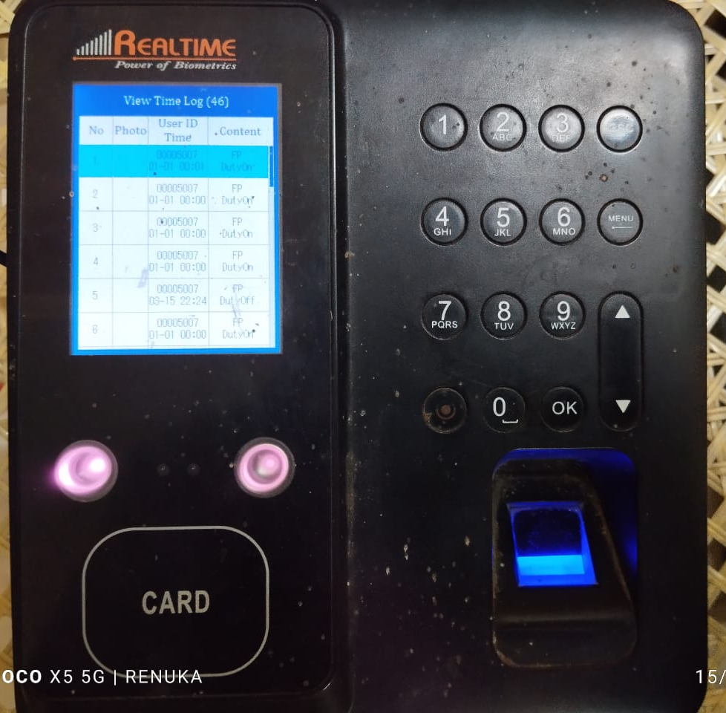
What is Biometric ?
Biometric Identification Systems are widely used for unique identification of humans mainly for verification and identification. Biometrics is used as a form of identity access management and access control. So use of biometrics in student attendance management system is a secure approach. There are many types of biometric systems like fingerprint recognition, face recognition, voice recognition, iris recognition, palm recognition etc. In this project, we used fingerprint recognition system

Slide 9
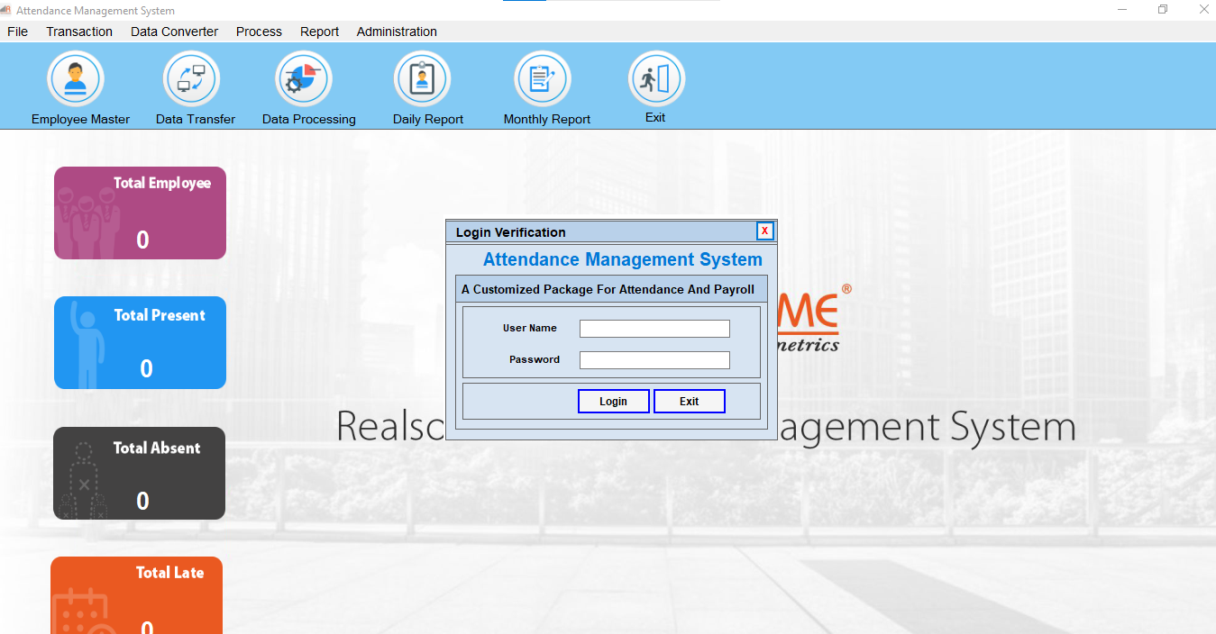
What is RealTime Software ?
This software specific to machine means different biometric machine has different software of particular company.
Here we are using RealTime T304F biometric machine for that system we use RealTime Tracker 11.7
Realtime software is use to download the data from biometric machine between two dates. Also for taking report of attendance.

Slide 10

Message Module
Vonage is an American cloud communications provider operating as a subsidiary provider operating as a subsidiary of Ericsson.
Vonage is leading VoIP and Ucaas services provider ,offering a realiable ,all-in-one solution for businesses of any size. With Vonage ,you can enjoy crystal-clear voice and video calls , instant messaging , and a host of advanced features, all integrated into one easy-to-use platform.
We can send 100+ messages /day and 10000+messages /month using Vonage Premium

Slide 11
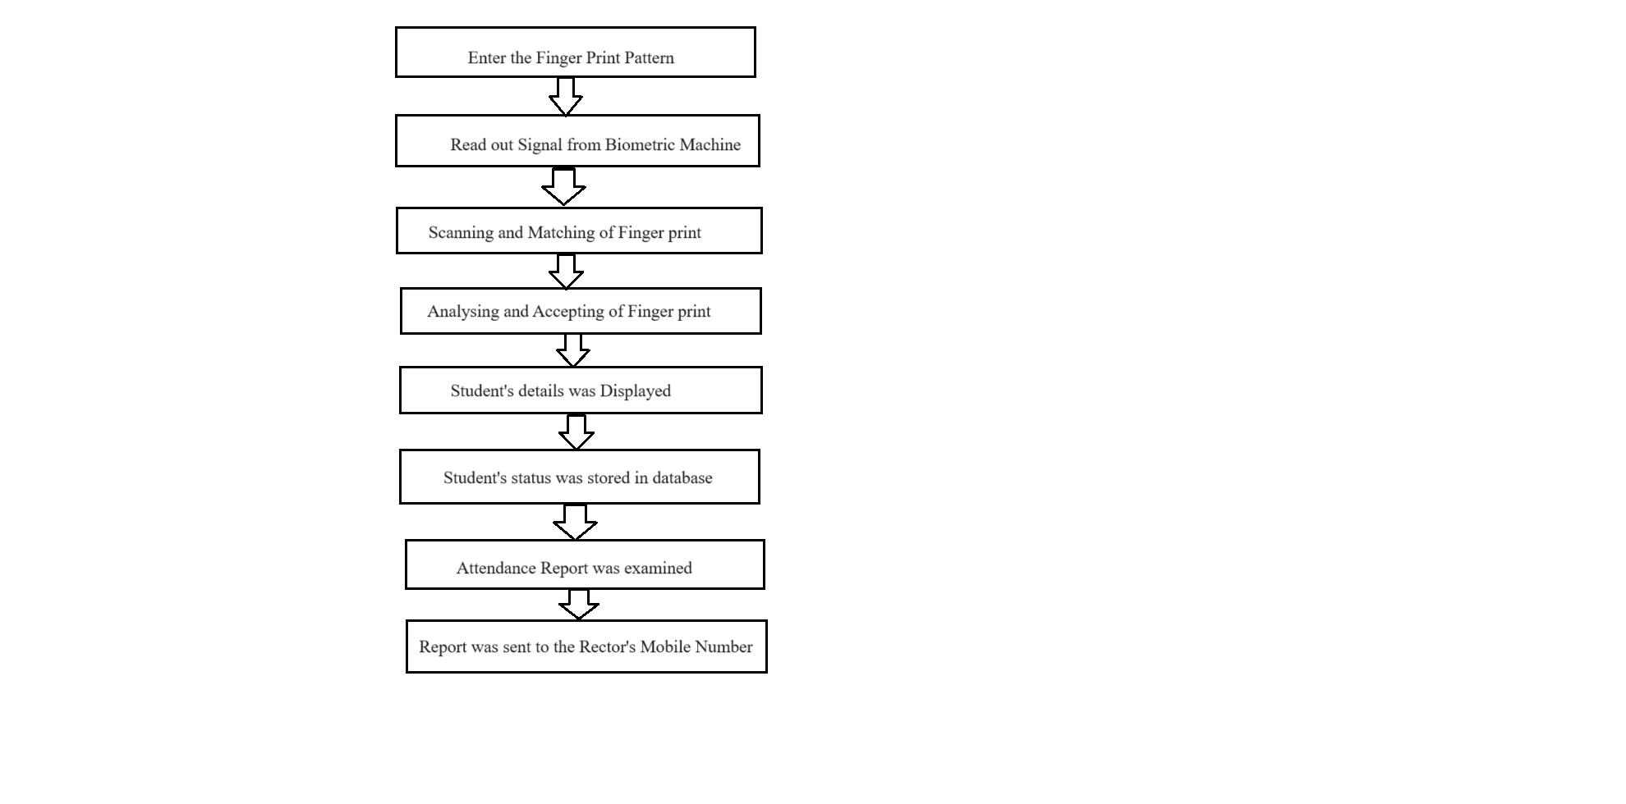
Methodology

Slide 12
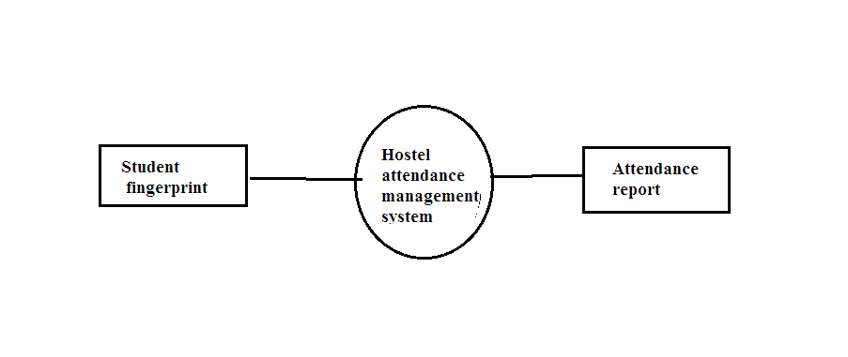
DFD Diagrams:-
Level -0:-

Slide 13
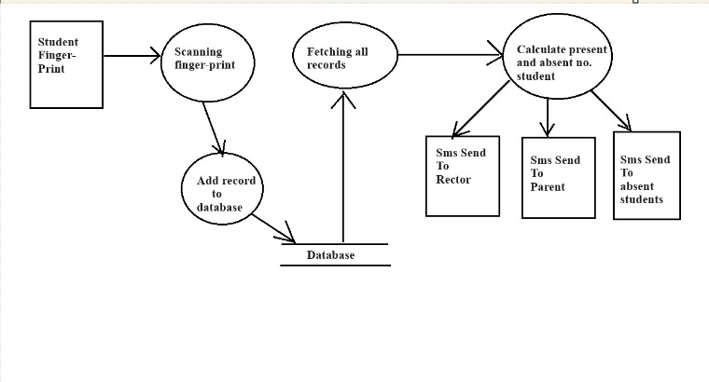
Level-1:-

Slide 14
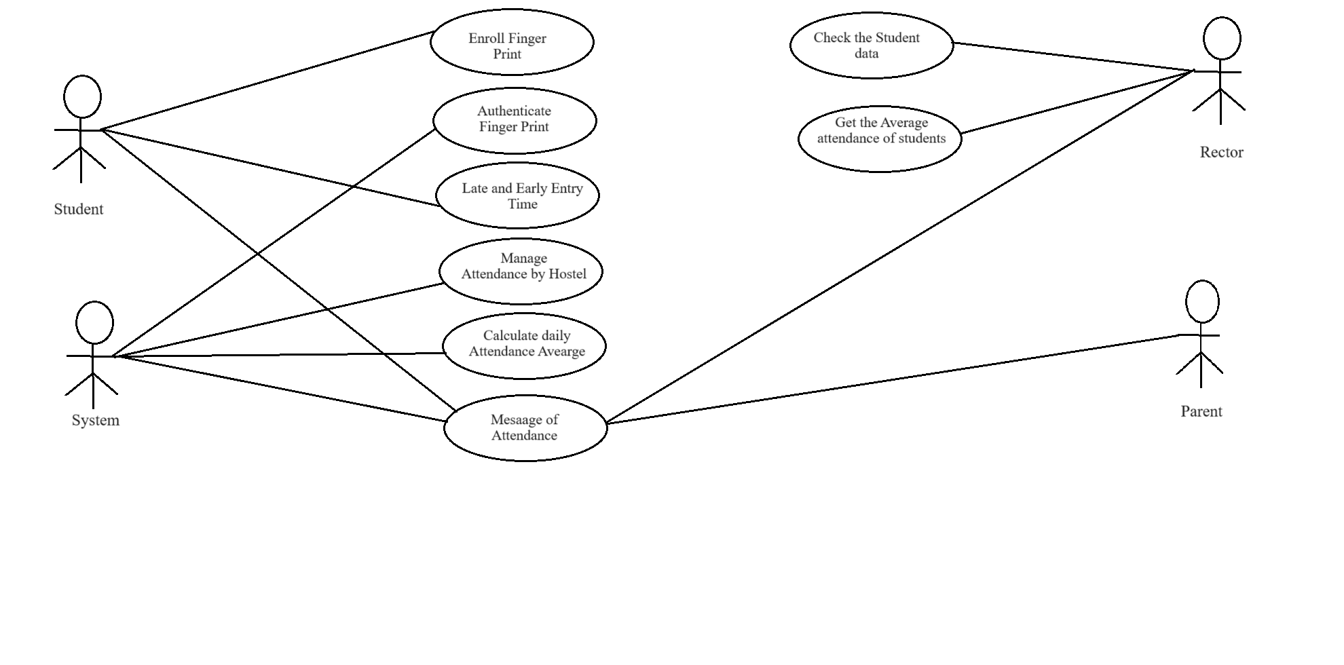
Use Case Diagram:-

Slide 15
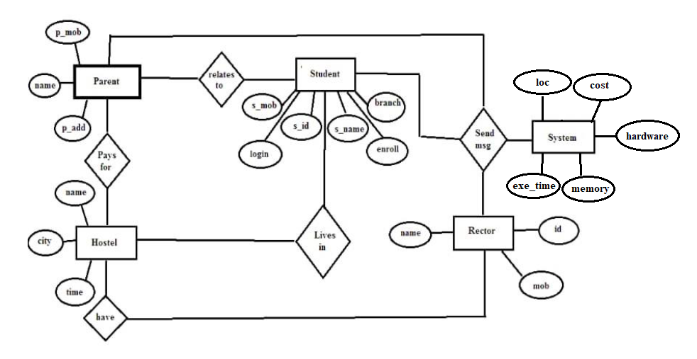
ER Diagram:-

Slide 16
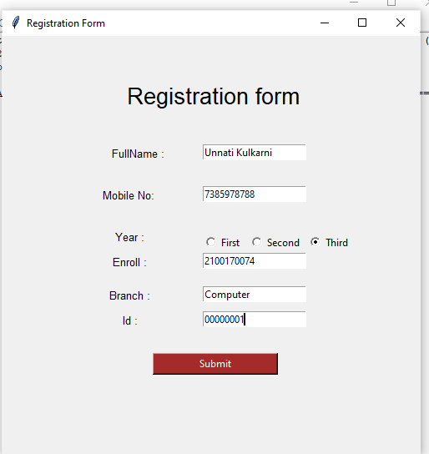
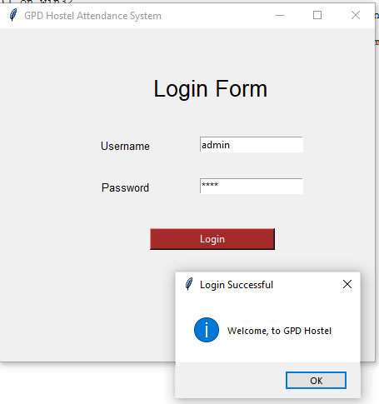
Output:-

Slide 17
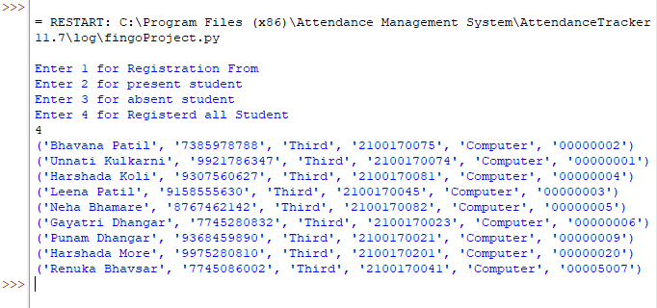
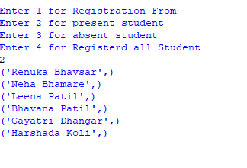
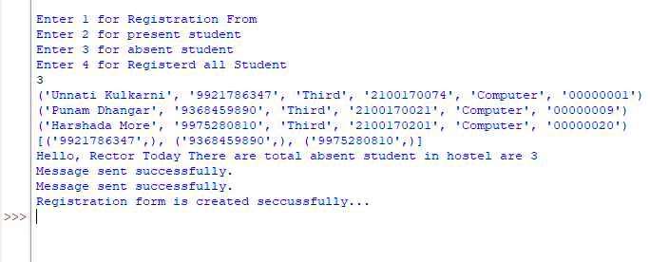

Slide 18
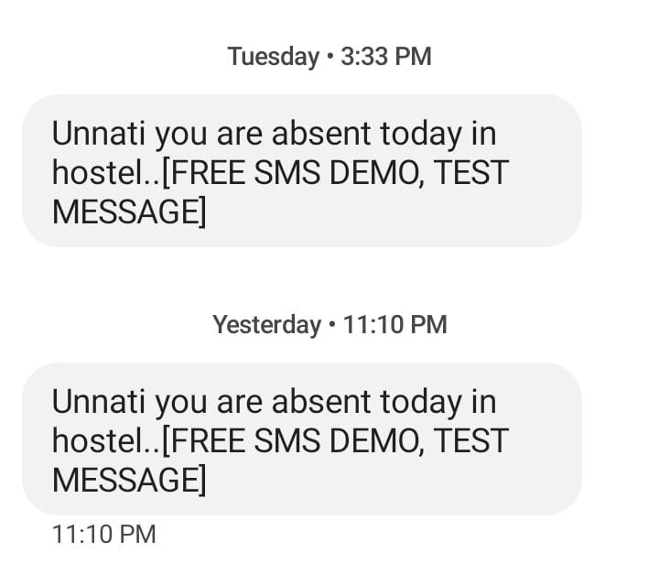
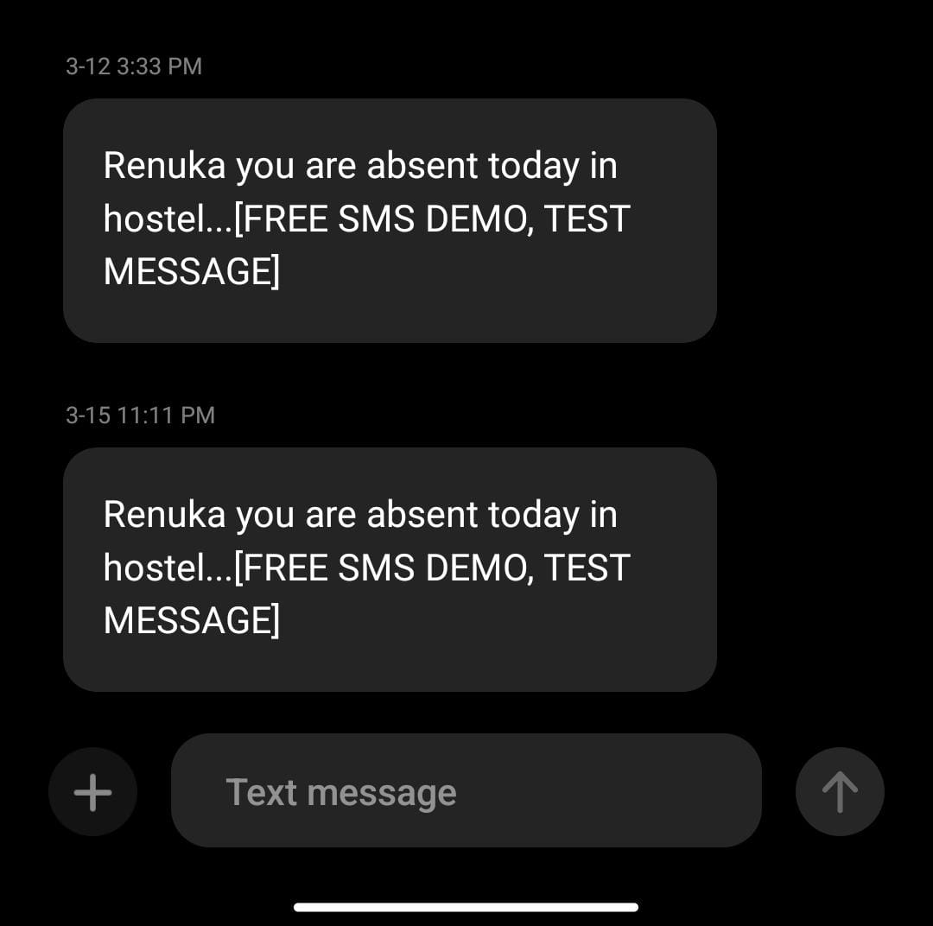

Slide 19
Resource Required
Hardware Interface
Device - DELL
Processor - Intel(R) Core(TM) i5-2540M CPU @ 2.60GHz 2.60 GHz
Installed RAM - 8 GB
System Type - 64 bit operating system, x64 bit –based processor
Windows Edition - Windows 10
Biometric Machine - T304F
Software Interface
RealTime Attandance Tracker
Frontend :- Designing GUI using Python
Backend :- MySql Database

Slide 20
Future Scope
We can also build this project by using cloud computing by means our data is stored on cloud rather than store it manually and everyone should access it. And by using cloud computing our storage is also saved. This project become more flexible by using cloud computing.
On this level our project is perfectly work on 10-11 girls in hostel. We can make several improvement in that project that it will be work properly on the data of 150-170 girls. And we can also we it for the purpose of boy’s hostel.
In this project we also add the module of location by this we can track the location of registered mobile number and if the location is out of city of college the we will inform their parents about their current location. So that the parents have no need to worry much about their children.

Slide 21
Conclusion
From this attendance project, we learn:
The importance of leveraging technology to enhance safety and efficiency in communal living environments.
This proposal will reduce manpower, and investment of the management. By this system we can easily approach and pass the information to the parents
The value of proactive measures, such as instant alerts for missing individuals, in ensuring the well-being of residents.
The potential for software solutions to make a tangible difference in improving the hostel experience for both administrators and residents.
The significance of user-friendly interfaces and comprehensive reporting capabilities in streamlining administrative tasks and promoting accountability.
Biometric technology may be a reliable tool for authentication.

Slide 22
Reference
Barbadekar Ashwini, “Performance Analysis of Fingerprint Sensors”, Vishwakarma Institute of Technology, Pune, 2010.
Mohamed Basheer K P, Raghu C V, “Fingerprint Attendance System for classroom needs”, NIT Calicut, Kerala, 2012.
Murizah Kassim, Hasbullah Mazlan, Norliza Zaini, Muhammad Khidhir Salleh “Web-based Student Attendance System using RFID Technology” 2012 IEEE.

Slide 23
Ask Questions :
Q/A

Slide 24

Thank You

